Slide 1
GROUP 18
Aleksandra Kondracka
Thomas Cherry
Xiaofei Guo
Yi Luan
Kanlin Cheng
James Steeper

Slide 2
CLICK TRAVEL
Business travel booking
Websites
Services
Efficiency

Slide 3
SKILLS
Java Programming
Web Development
Database Management
mySQL
Agile Development
Trello
Documentation

Slide 4
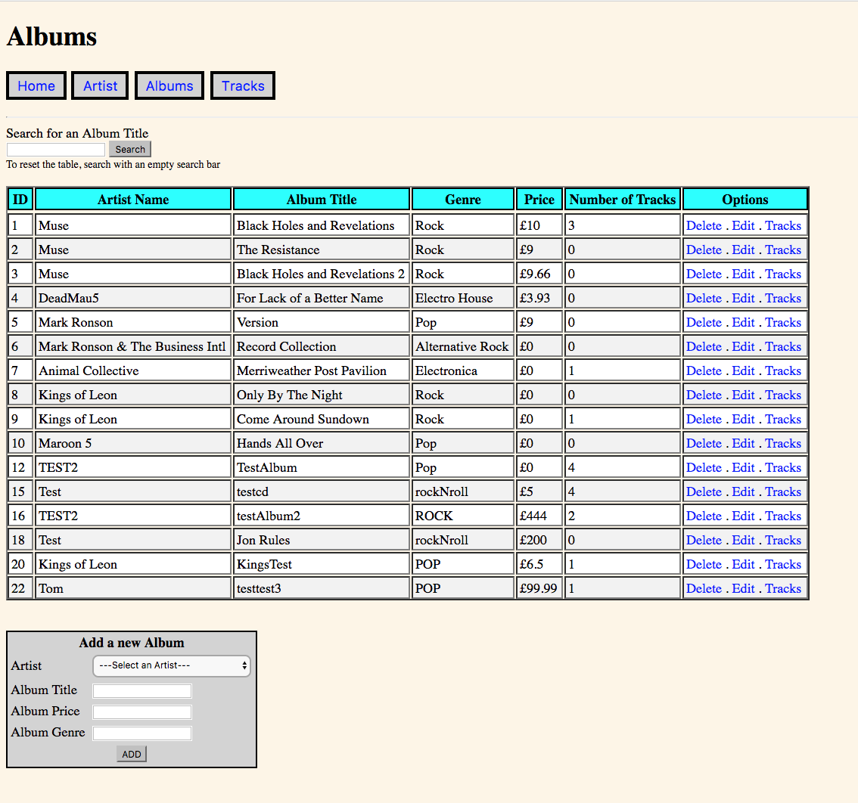
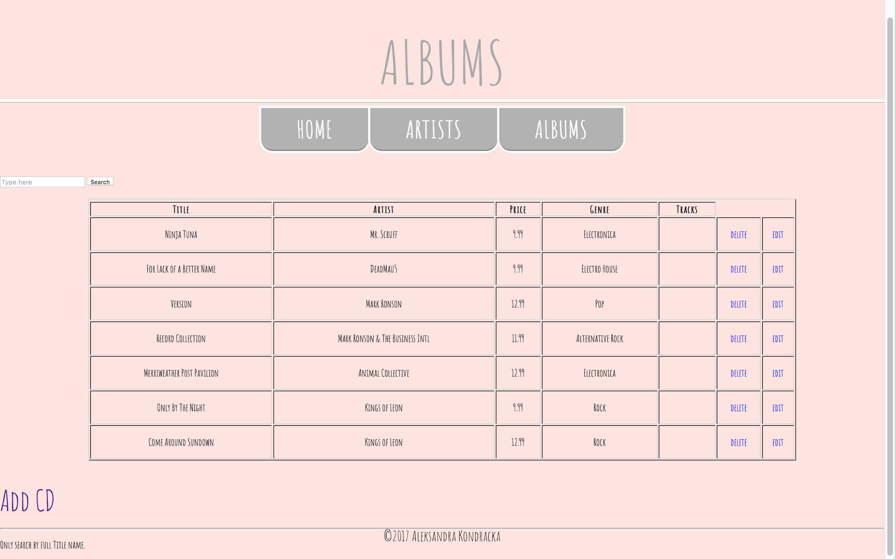

Slide 5
SKILLS
Java Programming
Web Development
Database Management
mySQL / NoSQL
Agile Development
Trello
Documentation

Slide 6
Our Vision
Review process
What could be included in the review
Star rating, Description, Highlight
Application layout
Consistent with current layout
Multi-Platform (Angular: Karma)

